Slide 1
EHAILING FM
Rideshare Online Radio

Slide 2
RIDESHARE ONLINE RADIO
we are drivers too

Slide 3
ABOUT US
EHAILING.FM
A global Online Radio for E-Hailing / Rideshare / On-Demand Apps targeted industry. Country will have their own local chapter of eHailingFM handled by local team-player.

Slide 4
PROBLEM
No radio that being designed to cater the needs for e-hailing / rideshare / on-demand apps driver (a.k.a The Driver) to listen too.
Normal terrestrial or online radio station tend to play music and information not related to the driver needs (e-hailing current news/issues, traffic update etc.)

Slide 5
MARKET GROWTH
Growth factors:
increase of the prices of fuels and vehicles such as the car has resulted in a declining number of car owners
integration of ride-sharing services with the smartphones

Slide 6
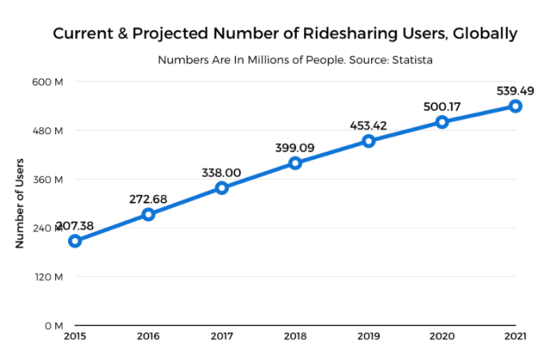
MARKET GROWTH
Increment of usage of passenger vehicles in Asia-Pacific, Middle-East and Africa expected will set the growth in ride sharing market over the forecasted period of 2018-2025

Slide 7
OUR BIG IDEA
EHailingFM mission is to become the global leader on E-Hailing / Rideshare / On-Demand Apps targeted industry for providing a real time information, fresh music and related updates to drivers and their passenger.

Slide 8
BUSINESS MODEL
1
2
3
Technology
Financial
Advertisement Offers
Key areas of technology needs to make eHailingFM business reaching it goals.
To manage the financial with a good governance. through financial funding and their controller
Advertisement slots on EHailingFM online radio and/or on the website / mobile apps

Slide 9
TECHNOLOGY
Mobile apps for Online Radio that includes digital wallet based on blockchain technology
Global portal system that includes merchant tool and payment system to accompany a music label ordering and streaming

Slide 10
FINANCIAL
RM50,000
Self Funding
(Initial capital, CAPEX and OPEX) has been done to start the EHailingFM.
100M Token
Token Presale
(CAPEX and OPEX) . Crowd funding as utility of Token Sale to generate new funding for EHailingFM project.

Slide 11
EHFM TOKEN
A TOKEN to generate new funding to eHailingFM project. It is a token based on ERC20 token technology. It is based on Ethereum blockchain and support Native Token Dex.

Slide 12
FINANCIAL
CROWD FUNDING (TOKEN UTILITY PRESALE)
TOKEN NAME : eHailing.FM
TOKEN SYMBOL : EHFM
TOKEN TECHNOLOGY : ERC20
TOKEN TOTAL QUANTITY : 100 MILLION
TOKEN SALE VALUE (PUBLIC PHASE 1 - 40 MILLION) : 0.00025 ETH EACH
TOKEN SALE VALUE (PUBLIC PHASE 2 - 40 MILLION) : 0.00028 ETH EACH
TOKEN SALE VALUE (PRIVATE – 10 MILLION) : 0.00022 ETH EACH
TOKEN HELD FOR BOUNTY PROGRAM : 4 MILLION
TOKEN HELD BY DEVELOPER (EHAILINGFM) : 3 MILLION
TOKEN HELD BY ADVISOR : 2 MILLION
TOKEN HELD BY FOUNDING MEMBER : 1 MILLION
TOKEN DEX SUPPORT : NATIVE DEX
TOKEN USAGE : UTILITY
100M Token

Slide 13
FINANCIAL
TOKEN DISTRIBUTION
Token Management
Token Distribution Schedule
Any ERC20 based ETH wallet for usage and management
Any un-sellable EHFM TOKEN will be put on sales via any ERC20 EXCHANGER based on the real market value
ERC20 exchanger listing will be done by end of 2020 or as early as 2021
PUBLIC FIRST BATCH TOKEN SALE will be held started on 15th October 2019 AT 0.00025 ETH.
PUBLIC SECOND BATCH TOKEN SALE will be held started on 15th December 2019 AT 0.00028 ETH.

Slide 14
FINANCIAL
TOKEN BUY BACK PROGRAMME
(guaranteed 20% buy back value)
Token Buy Back Value
Buy Back Programme Suggested Date
1st BUYBACK (30M) : 0.00030 ETH EACH
2nd BUYBACK (30M) : 0.00030 ETH EACH
1st BATCH : 15TH JANUARY 2021
2nd BATCH : 15TH JUNE 2021

Slide 15
FINANCIAL
TOKEN ECOSYSTEM
1st Initiative
To develop an online radio mobile apps
2nd Initiative
3rd Initiative
To develop a payment module within the mobile apps
To develop a music portal

Slide 16
FINANCIAL
ADVERTISING OFFERS
Advertisement Slots
Contact
Offers to all clients / token owners to have their advertising slot on EHailingFM online radio and/or on the website / mobile apps
The rate card for advertising slots are different between each local chapter.
Payment shall be done using EHFM TOKEN
Local chapter / advertising@ehailing.fm

Slide 17
KYC / AML
Know Your Customer / Anti Money Laundering
Online form to ease CROWD FUNDING and TOKEN SALES
Security mechanism to ensure accuracy of data and information regarding token holder

Slide 18
FUTURE / GLOBAL EXPANSION
WORLDWIDE CHAPTER
Chapter Based
Licensing Fees & SOP
Designed to be handle worldwide based on chapter
Each selected country will have a local chapter with their own operating autonomy
Control advertiser placement and others daily operation with a ‘Standard Operating Procedure’
The local chapter need to pay a standard yearly licensing fees
two type of licensing fees need to be paid upon opening any local chapter.
One-time setup fees
Yearly operating fees
paid using either BITCOIN or ETHEREUM
Twice a year all local chapter shall be needed to present their progress report
Introduce new technology and other businesses for targeted to handle IR4.0 and Internet / Media model

Slide 19
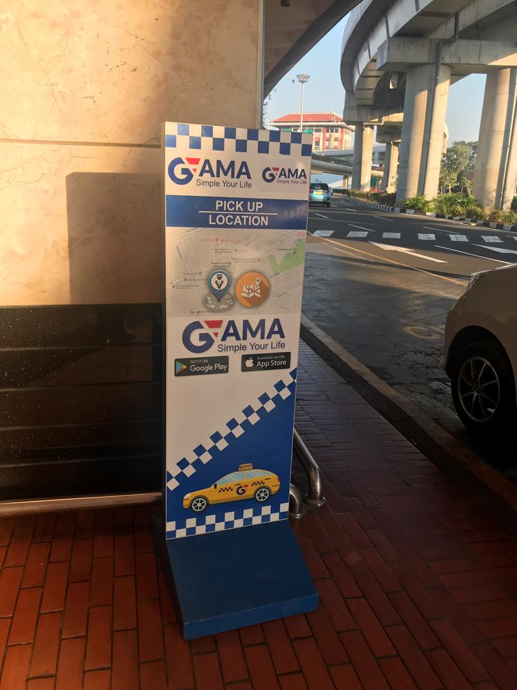
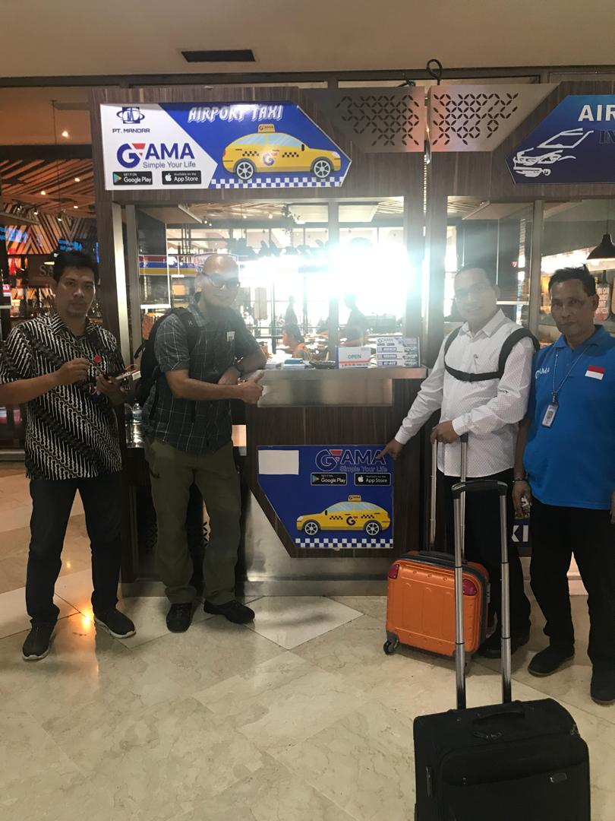
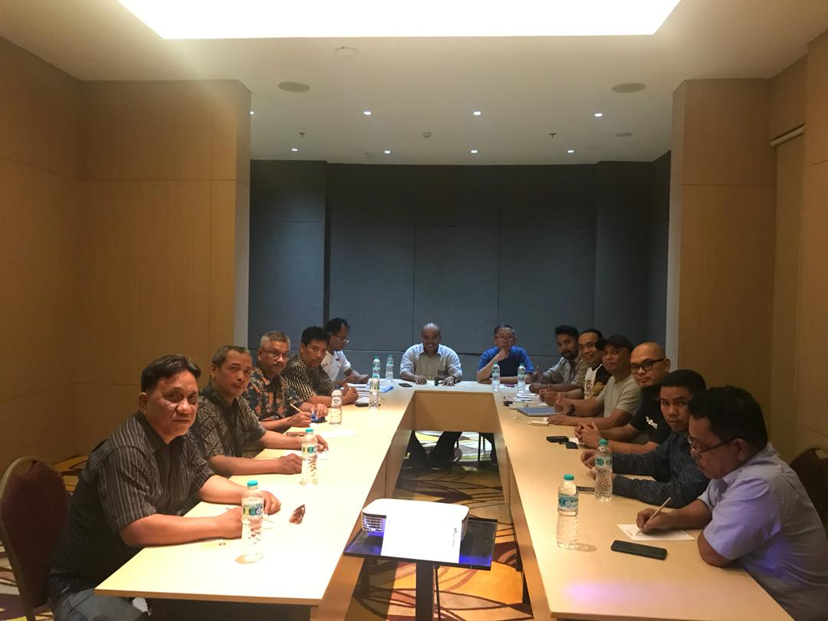
GLOBAL PARTNER
INDONESIA CHAPTER
New Chapter
INDONESIA – PT GAMA (on August 2019)
New interested partner : localchapter@ehailing.fm

Slide 20
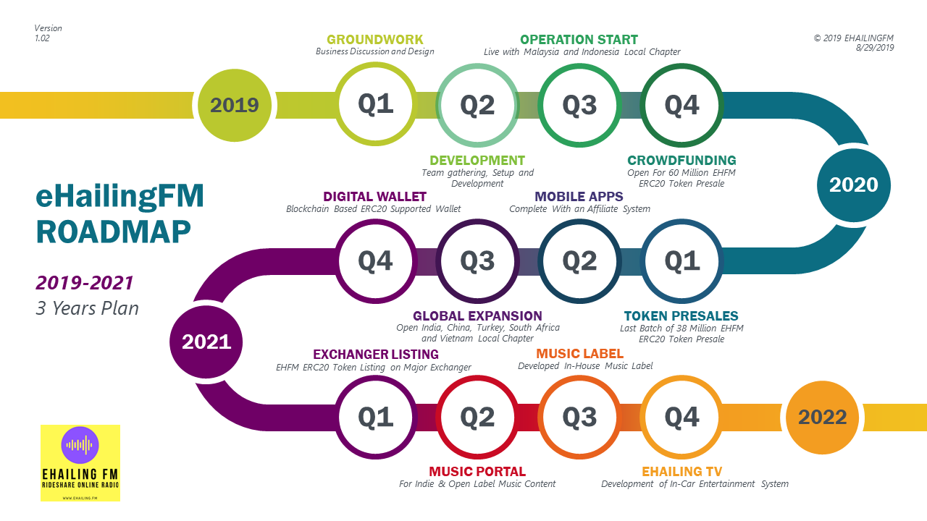
ROADMAP

Slide 21
THANK YOU!
EHailing FM
Phone:
+60-173-840838
Email:
contactus@ehailing.fm
Website:
http://www.ehailing.fm

